Slide 1
THE ROLE OF NBFI IN FINANCIAL INCLUSION
TWENEBOAH KODUA BOAKYE, BSc. (Engineering), LLB, MBA (Finance), CA, CEMF
CHIEF EXECUTIVE OFFICER (CEO)
GHANA ASSOC. OF SAVINGS & LOANS COMPANIES (GHASALC)

Slide 2
OUTLINE
Background
Key Characteristics
Types of NBFIs
S&Ls in Ghana
Role & Importance
Challenges Facing NBFIs
The Future of NBFIs
Conclusion
Achieving Financial Inclusion
Impacting The World

Slide 3
BACKGROUND
What is an NBFI?
Non-Bank Financial Institution (NBFI)
Financial Service Providers that offer banking-like services but do not hold a full banking licence.
It is a creature of statute – Jurisdiction matters
Relating or being an entity other than a bank

Slide 4
KEY CHARACTERISTICS
No Banking License – They normally do not accept demand deposits (like current accounts) but can offer other financial services.
Regulated Differently – They operate under specific financial laws but are not subject to the same stringent regulations as commercial banks.
Diverse Services – They provide loans, microfinance, leasing, insurance, remittances, mobile money, and investment products.
Target Underserved Markets – They often serve SMEs, low-income individuals, and informal businesses that lack access to traditional banking.
Flexible and Innovative Products – Quickloan by Letshego, Pay-as-you-go solar financing (e.g., M-KOPA

Slide 5
TYPES OF NBFIs
THE FINANCIAL SECTOR
S&L /
Microfinance (DTI)
Insurance
Pension
Leasing & Finance
EMIs & FinTechs
SACCOs (Credit Unions)
Remittances
Capital Market Intermediaries

Slide 6
TYPES OF NBFIs
Microfinance Institutions (MFIs) – Provide small loans and savings products to low-income individuals (e.g., Equity Bank started as an NBFI in Kenya as Equity Building Society in 1984).
Insurance Companies – Offer life, health, and agricultural insurance (e.g., Sanlam in Ghana and South Africa).
Pension Funds – Manage retirement savings (e.g., United Pension Trustees (UPT) in Ghana offers personal pension – My Own Pension, and Petra offers ).

Slide 7
TYPES OF NBFIs – cont.
Leasing & Finance Companies – Provide asset financing for businesses (e.g., vehicle and equipment leasing firms).
Mobile Money & FinTech Operators – Digital financial services like M-Pesa (Kenya), MTN Mobile Money (Ghana, Uganda), Jumo, Carbon, Paga (Nigeria)
SACCOs (Savings & Credit Cooperatives) – Member-based financial cooperatives (common in East Africa).
Capital Market Intermediaries – Stockbrokers, investment funds, and venture capital firms. Cowrywise (Nigeria) - enables low-income earners to invest in mutual funds

Slide 8
Some Examples
Some Leading Examples
M-Pesa (Kenya) – Mobile money platform by Safaricom.
Letshego (Pan-African) – Microfinance and lending services.
Jumo (South Africa) – Fintech lending platform.
Baobab Group (West & North Africa) – Digital microfinance services.
MFS Africa, Wave (Senegal)
SOME BANKS STARTED AS NBFIs
Equity Bank (Kenya), BPR (Rwanda), UBA (Nigeria), Fidelity (Ghana), Bank of Africa (acquisitions or transformation).
Insurance Penetration through Collaboration – NBFIs/FinTechs
Notes:
Why Did These MFIs Transition into Banks?
Growing Customer Base – Successful MFIs attracted more depositors, requiring a banking license.
Regulatory Upgrades – Some countries allowed strong MFIs to convert into banks (e.g., Kenya, Nigeria).
Access to Cheaper Funding – Banks can take deposits and access interbank markets, unlike MFIs.
Expanded Services – Becoming a bank allowed them to offer more products (loans, forex, trade finance).

Slide 9

SAVINGS & LOANS COMPANIES IN GHANA
Licensed to do banking business except FOREX (Act 930)
26 Licensed Companies
Minimum Paid Up Capital: $1 million (GHS15 million) - Review
Total Assets (Dec. 2025): Aprox. $621 Million (GHS9.63 Billion)
Clientele: 6 Million Depositors
Employment: 8,500+ direct employees
Products & Services: All Financial & Non-Financial (except)
Key Players: Letshego, Bayport, ASA, Sinapi Aba, Best Point, Opportunity International, Multi-credit, Izwe, Advans Ghana, etc.

Slide 10
The S&Ls Experience in Ghana
Letshego – Quick Loan with MTN - Example: Letshego Ghana Savings and Loans' partnership with MTN Mobile Money enables the S&L to lend to over 34,000 persons on a daily basis. Cash at your fingertips. 22bn. Cedis to 6.9 million wallet holders (since 2017). Disburse these loans within 3 minutes and with ease.
Pan-African – Quick Platform and the Mama Group Product with Medical Assistance
Sinapi Aba – Entrepreneurship and Young Business Owners Drive
Opportunity International – Youth Start Up Credit and Mobile Apps.
Bayport – Scholarship and other financial literacy programmes to support communities
MultiCredit – Scholarships and Inclusive finance products.
ASA and Adehyeman’s Group Loan to bring relief to thousands of households (NPLs tamed)

Slide 11
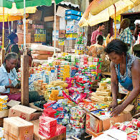
THE ROLE OF NBFIs
Financial Inclusion
Support for SMEs & Households
Economic Growth
Resilience
Social Improvement
Environmental Protection
Education & Health

Slide 12
THE ROLE OF NBFIs
Financial Inclusion – They reach unbanked populations through innovative solutions (mobile money, agency banking).
Support for SMEs – Provide credit to small businesses that struggle to secure bank loans.
Economic Growth – Stimulate entrepreneurship and reduce poverty by improving access to finance.
Resilience – Offer alternative financial services during banking and economic crises (e.g., Letshego and Pan-African S&Ls during COVID-19).

Slide 13
ACHIEVING FINANCIAL INCLUSION
FINANCIAL INCLUSION
ACCESS
Ability to use formal financial services, ie. Minimal barriers to opening account.
Physical proximity
Affordability
QUALITY
Product attributes match the needs of customers.
Product development considers the needs of customers.
USAGE
Actual usage of financial services & products.
Regularity
Frequency
Length of time used
WELFARE
Effect on the livelihoods of the customers
Welfare/consumption
Personal/business productivity

Slide 14

IMPACTING THE WORLD
Financial Health (UN GOAL)
This means having the right financial tools to manage day-to-day expenses, build resilience to financial shocks, and invest in the future. When these financial tools — like savings, insurance, payments, credit, and more — are designed with financial health and the needs of customers in mind, they can foster a more inclusive and sustainable financial ecosystem that supports financial stability, resilience, and long-term prosperity for everyone.

Slide 15
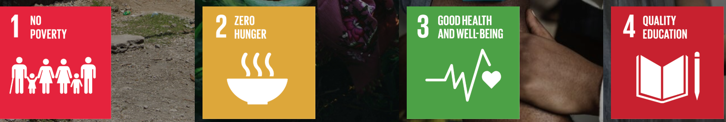





IMPACTING THE WORLD

Slide 16

The Impact Story
During a country visit to the Philippines in May 2024, UNSGSA Queen Máxima spoke with a local fisher who has doubled his fish cage business since taking out loans from CARD-RBI, a microfinance-oriented rural bank.
He is also safeguarding his livelihood with savings and life microinsurance products, improving his financial health..
Photo: Patrick van Katwijk
Notes:
UNSGSA stands for United Nations Secretary-General’s Special Advocate for Inclusive Finance for Development

Slide 17
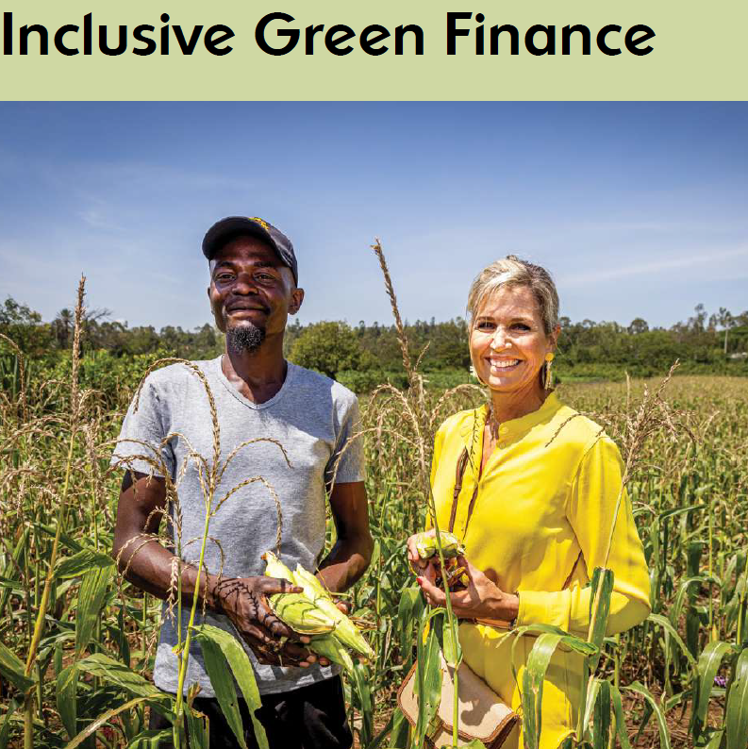
The Impact Story
During a visit to a farm in Kisumu, Kenya, on 23 October 2023, Queen Maxima met with Onesmus, a smallholder farmer who is benefiting from digital agricultural insurance, which is bundled with access to seeds and fertilizer on credit, through a partnership between insure-tech company Pula and agtech firm Apollo. The insurance payouts he has received have helped him be more resilient to shocks as he was able to avoid borrowing money to recover from two harvest losses. His payouts were used to pay his children’s school fees and expand his farm from four to six acres.
Photo: Patrick van Katwijk

Slide 18
CHALLENGES OF NBFIs
Regulatory Hurdles – Some countries impose restrictive policies on non-bank service providers.
Limited Funding – Many rely on donor funding, high-interest loans, or deposits, limiting scalability. High Interest Rates
Fraud & Risk Management – Weak internal controls in some institutions lead to high default rates. And Trust Issues
Competition from Banks – Traditional banks are now expanding into digital finance, increasing competition.
Technology / Connectivity
Public Confidence – Interest Rates and Other Environmental Effects

Slide 19
ADDRESSING THE CHALLENGES
Partnerships with Telcos and FinTechs
Educational Campaigns to improve digital literacy
Implementation of Credit Scoring & AI Enabling Tools
Enhancing Security Measures for Agents
Transparent Claims/Redemption/Withdrawal Processing
Public Awareness Campaigns
Building Cybersecurity Enabled Environment – ISO Certification

Slide 20
THE FUTURE
Digital & FinTech-Driven Expansion – Mobile Money & Digital Wallets, AI & Big Data, Blockchain & DeFi
Impact: NBFIs will need to leverage technology to reduce costs, reach rural areas, and compete with banks.
Regulatory Sandboxes & Licensing Reforms
Impact: Easier compliance could help NBFIs scale while maintaining consumer protection.
Rise of Hybrid Financial Models – Partnership with Banks, Neobanks & Digital-Only NBFIs, Embedded Finance
Impact: NBFIs will increasingly function like banks without holding full licenses.
Rise of Hybrid Financial Models – Partnership with Banks, Neobanks & Digital-Only NBFIs, Embedded Finance
Impact: NBFIs will increasingly function like banks without holding full licenses.

Slide 21
THE FUTURE (cont.)
Focus on Climate & Agri-Finance – Green Bonds & Climate Funds, Index-Based Insurance (e.g. Pula (Africa)
Impact: NBFIs will help mobilize capital for sustainable development.
Increased Competition & Consolidation – Big Tech, Mergers & Acquisitions
Impact: Smaller NBFIs may merge, while agile digital players will thrive.
Regulations and Cybersecurity– Deployment of Systems, Risk Management, Product Differentiation
Increased Collaborations and adoption of Open-Source Platforms
Government and Regulatory Support

Slide 22
CONCLUSION
NBFIs are key pillars of our respective countries’ Financial Future
NBFIs will remain vital for Financial Inclusion, SME growth, and Digital Innovation, but their success depends on: ✅ Smart regulation (balancing innovation & stability). ✅ Tech adoption (AI, blockchain, mobile money). ✅ Strategic partnerships (with banks, telcos, fintechs).
The future is digital, inclusive, and collaborative, with NBFIs at the heart of our economic transformation.

Slide 23

Tweneboah Kodua Boakye, BSc., LLB, MBA, CA, CEMF
CEO, Ghana Association of Savings and Loans Companies (GHASALC)
+233 54 341 1467
tweneboah1@yahoo.com

